Slide 2
Agenda
Background
Vision
Key Questions
Criteria
Illustrative Market Timeline
Recommendation
Options Considered
Illustrative Timeline for Options
Face Lifted UI

Slide 3
Background
Business drivers changed (e.g. single thin UI)
Re architect instead of re write
Conducted proof of concept
Challenged previous thinking
Business enhancements identified
Bid expectations raised
End state envisioned
Refined estimates for re architecture

Slide 4
Vision
Version 4 Current
  VB Omiga and Supervisor
Version 5 .Net
  .NET Supervisor and Omiga, SQL Server 2005, IE7
Version 6 Partial SOA
  Service Layer, New UI
Version 7 Full SOA
  Service implementation

Slide 5
Key Questions
Version 5
  Re Architect or Migrate Supervisor?
Version 6
  SOA depth or width?

Slide 6
Criteria
Earliest to .NET
Amount of end state Vertex work vs throwaway AiS development
Earliest to service layer (Width)
Earliest to a full SOA service (Depth)
Earliest to consistent UI
Easiest to add BAU updates
Earliest to allow choice to incorporate 3rd party component
Earliest to end state

Slide 7
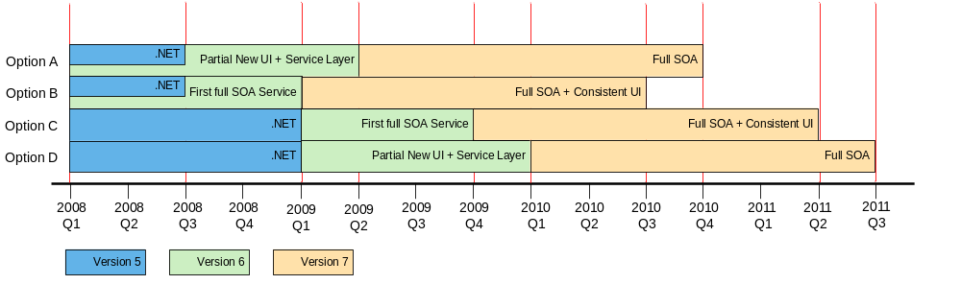
Illustrative Availability of Key Saleable Features

Slide 8
Recommendation
Migrate Supervisor, Service Layer (option A)
  Version 5 delivered quicker than re-architecture
  Version 6 starts in parallel
  Full service layer in version 6
  Full new consistent UI in version 6
  Least delivery risk for version 5:
    Version 5 is outsourced to AiS
    Extended window for training staff
  Less rework of Supervisor
  Current Product clients can take version 5

Slide 9
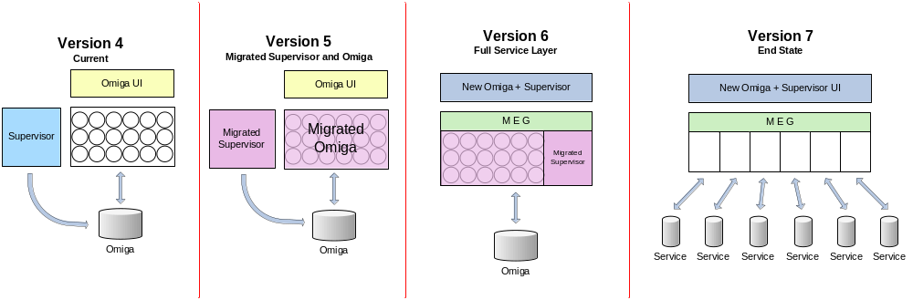
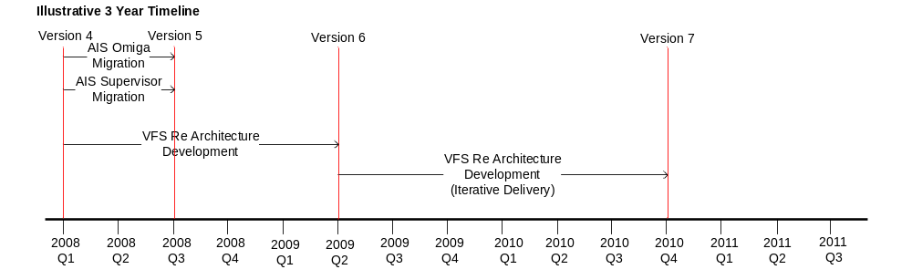
Option A

Slide 10
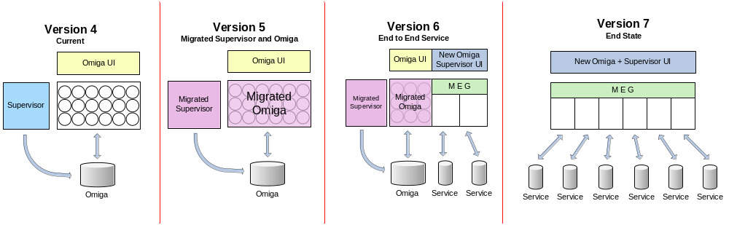
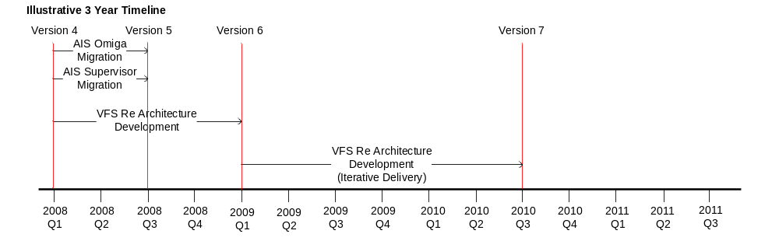
Option B

Slide 11
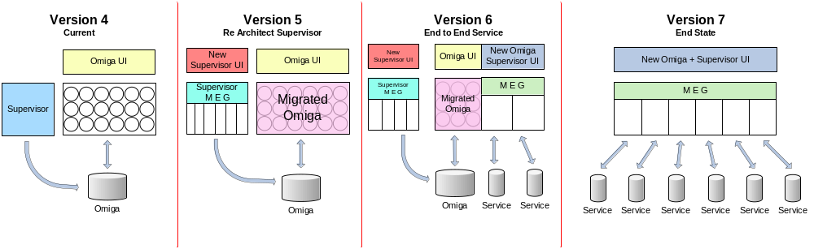
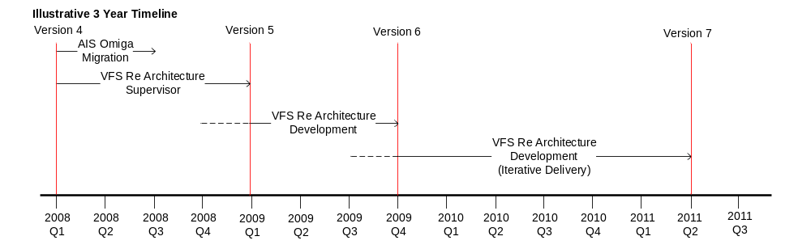
Option C

Slide 12
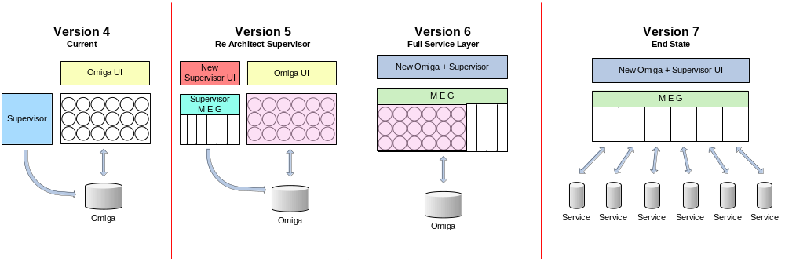
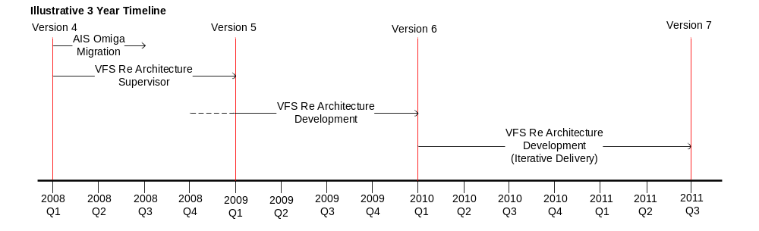
Option D

Slide 13
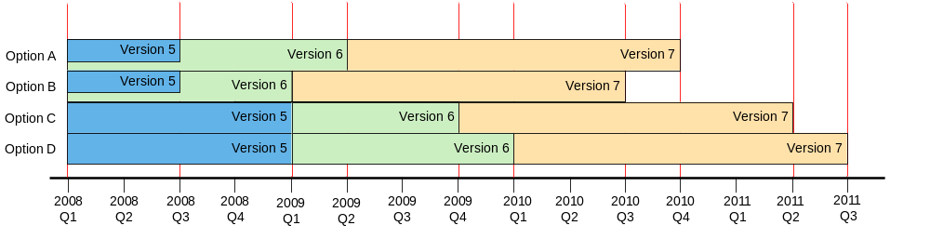
Illustrative Roadmap Option Timelines

Slide 14
Estimated effort for Version 5 options
  5A Re Architect Supervisor – 1959 days
    1849 person days
    Excludes project management
    Excludes Supervisor UI
    100 days for infrastructure
    10 days face lift Omiga UI
  5B Migrate Supervisor – 218 days
    198 person days
    10 days skinned UI and single click deployment
    10 days face lift Omiga UI

Slide 15
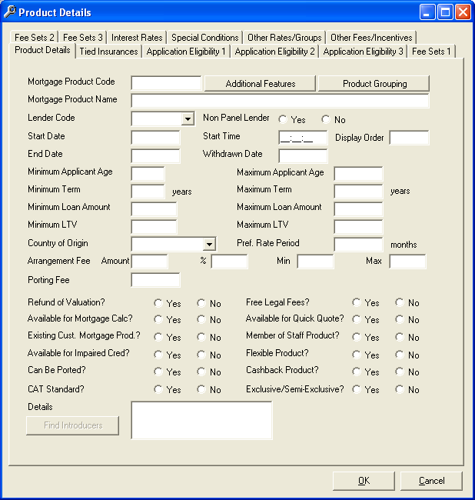
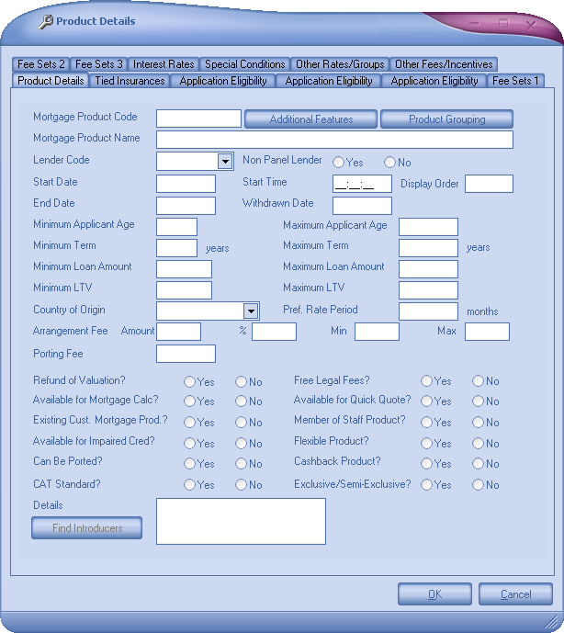
Sample Face Lift UI Supervisor

Slide 16
Further Considerations
When to incorporate
  New Business functionality
      Generic Fee Sets
      Rate Loadings
      Tranche Management
  Business as Usual Changes
Build or buy subsystems

Slide 17
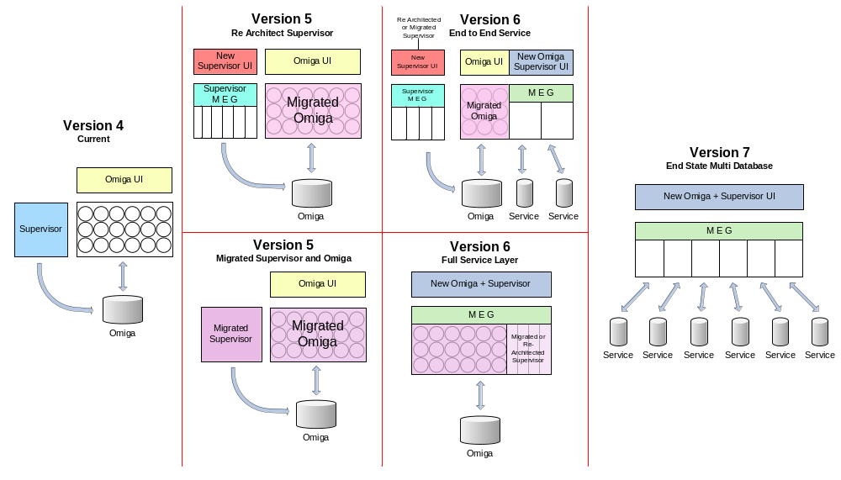
Options Overview
Notes:
Version 5
There are 3 possible options as detailed below:
Version 5A – Migrate Omiga + Re Architect Supervisor
All the existing functions developed in new technology
SOA, using end state technology e.g. WCF
No new business functionality
Version 5B – Migrate Supervisor and Omiga
Outsource migration of existing code to remove VB
Start work on version 6.
Version 6
There are 2 possible options as detailed below:
Version 6A – End to End Service
Version 6B – Full Service Layer

